Slide 1
K-Means Clustering
A unsupervised learning algorithm
Notes:
K-means is an unsupervised algorithm because it groups data points into clusters based on inherent similarities, without using predefined labels or a target feature. The algorithm learns patterns directly from the unlabeled data to form these groups, unlike supervised learning, which requires labeled data for training.

Slide 2
K-Means Clustering Algorithm
K
👆# of clusters
Select the number of clusters (K)
Randomly choose K initial cluster centres
Measure the distance between the 1st point and the K initial cluster centres
Assign the 1st point to the nearest centroids
Repeat step 3-4 for other data points
Calculate the mean of each clusters
Update centroids as mean of assigned points
Repeat the above steps by keep re-clustering and recalculating the mean of each cluster until it finds the best possible value of K

Slide 3
Bad VS Good Clustering
Adding up the variation within each cluster
We want smaller variations
Variation = 0 when there is only one point per cluster

Slide 4
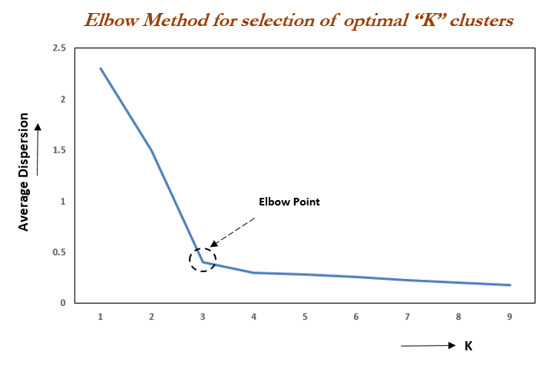
The Elbow Method
Finding Optimal K
The value of K at which improvement in variation declines the most is called the “elbow”, at which we should stop dividing the data into further clusters.
Notes:
The elbow method is used to determine the optimal number of clusters in k-means clustering. The elbow method plots the value of the cost function produced by different values of k. As you know, if k increases, average variation will decrease, each cluster will have fewer data points, and the data points will be closer to their respective centroids. However, the improvements in average variation will decline as k increases. The value of k at which improvement in distortion declines the most is called the elbow, at which we should stop dividing the data into further clusters.

Slide 5
Linear Regression
A supervised learning algorithm
Gabrielle Wu
Notes:
Linear regression is a supervised learning algorithm because it requires a labeled training dataset—one where the correct output (or "label") is provided for each input—to learn the relationship between input variables and the continuous output variable it's trying to predict.

Slide 6
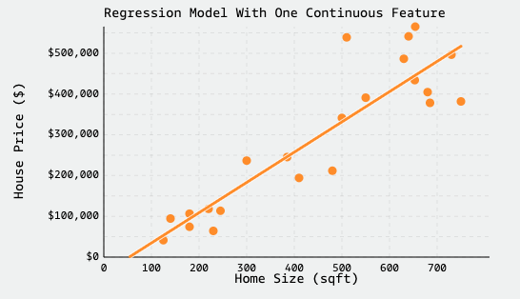
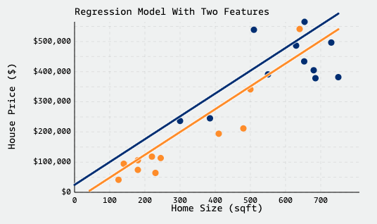
Simple Linear Regression
$$\overset{̂}{y}=β_{0}+β_{1}x$$
1. Fit a line that minimizes the error between predictions and actual values
Multiple Linear Regression
$$\overset{̂}{y}=β_{0}+β_{1}x_{1}+β_{2}x_{2}+…+β_{n}x_{n}$$
Notes:
y=predicted value
Beta0 = intercept
Beta1…n = corresponding coefficients
X1,x2,…, xn = input features

Slide 7
2. Error measured by residuals (difference between predicted and true Y)
$$e_{i}=y_{i}-{\overset{̂}{y}}_{i}$$
3. Uses Mean-Squared Error (MSE) to minimize the sum of squared residuals
$$MSE=\frac{1}{n}\overset{n}{\underset{i=1}{∑}}{\left(y_{i}-{\overset{̂}{y}}_{i}\right)}^{2}$$
Notes:
3. MSE quantifies how close a predicted value is to the true value, so we'll use it to quantify how close a regression line is to a set of points. MSE works by squaring the distance between each data point and the regression line (the red residuals in the graphs above), summing the squared values, and then dividing by the number of data points
The squaring of errors prevents negative and positive terms from canceling out in the sum,[ℹ] and gives more weight to points further from the regression line, punishing outliers. In practice, we'll fit our regression model to a set training data, and evaluate it's performance using MSE on the test dataset.

Slide 8
Real-World Use Cases
Stock market predictions
Real Estate price predictions
Sales forecasting
Notes:
Financial Forecasting: Financial analysts use MLR to predict stock prices or economic indicators based on multiple influencing factors such as interest rates, inflation rates and market trends. This enables better investment strategies and risk management24.
Real Estate Pricing: In real estate MLR is used to predict property prices based on multiple factors such as location, size, number of bedrooms, etc. This helps buyers and sellers understand market trends and set competitive prices.
Sales Analysis: An e-commerce company can utilize MLR to assess how various factors such as product price, marketing promotions and seasonal trends impact sales.

